Slide 1
Sunbury Health Centre Sunbury on Thames
www.sunburyhealthcentre-ppg.com
participation support influence encourage contribute enthuse guide share impact instigate aid benefit involvement

Slide 2
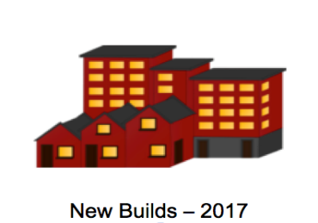
Building for 6,000 patient
Estimate 23,000 patients
19,000 patients
The Practice is ALREADY the LARGEST single premise Practice
in Britain!

Slide 3
Building owned and Maintained by NHS Property Services
GPs
Foundation Doctor
Practice Nurses
Phlebotomists
Admin Staff
Receptionists
Health Care Assistant
Podiatry
District and School Nurses
Health Visitors
Dressing Clinics
Speech/Language Therapy
Family Planning
45% rented by
Sunbury Health Centre
55% rented by
Virgin Care
86% undersized for the Practice

Slide 4
Resources stretched …
Not enough telephone lines
Not enough space
Difficulty in making appointments
Queues into the building
Cramped and poor conditions
Unwell patients outside in the poor weather

Slide 5
Dependencies
Strengths
Sunbury Health Centre
NHS
Property Services
NHS
England
Virgin Care
The PPG
The Patients
The Patients

Slide 6
Objectives for the Practice
PREMISES
Extend the premises … … NHSE, NHSP, Council, PPG
Move to new premises … … NHSE, NHSP, Council, PPG
Upgrade what there is … … PPG

Slide 7
Objectives for the PPG
PATIENTS
Increase the Patients’ Group Core Group
Inform and involve the patients – Public Meetings
SMS: Pre-appointment confirmations to reduce DNAs
Messaging for the hard of hearing
Overhauling the ‘loop’ hearing system
Create PPG Website
Produce quarterly Newsletters
Improve the internal aesthetics of the premises

Slide 8
Barrier No.1 … … … … …
Quote: NHS England - January 2015
Patients across England are set to benefit from a £250m investment in GP
premises every year for the next four years.
Excuses since 2013 on Five separate Applications
Lack of funding
Awaiting publication of NHS Premises Directive
Renaming the funding streams
Requiring 2 additional re-submissions for funds

Slide 9
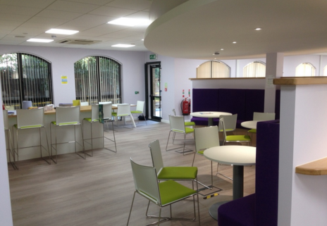
Barrier No. 2 … … … … …
Quote: NHS Property Services
“One of our roles is to help our customers find the right properties for their
healthcare needs.”
September 2015
NHS Properties stepped in to help the North West Surrey CCG to relocate from the offices it had outgrown.
The relocation package included securing funding of £700,000 from NHSE for the fit-out, furniture and IT.
http://www.property.nhs.uk/adding-value-improving-the-working-environment-for-commissioners-in-surrey/

Slide 10
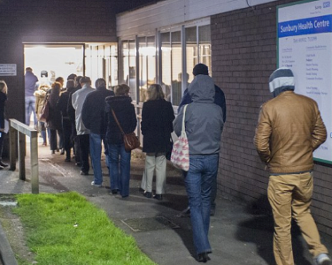
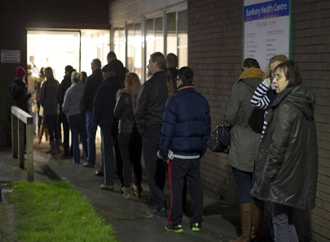
‘The Queues of Shame’ - The Daily Mail and The Guardian
14 and 23 December 2014
Sick and elderly patients queue from 7am at overcrowded Health Centre just to book an appointment.
“The facility we’ve got simply isn’t equipped to deal with the demand.”
Kwasi Kwarteng - The local Conservative MP

Slide 11
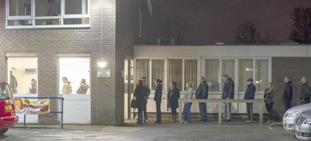
‘This is one of the worst buildings that we have seen!’

Slide 12
What has been achieved by the Practice …
On Line Bookings
Electronic
Repeat Prescriptions
4 x more Telephone Lines
26 New Computers
More Doctors/Nurses
More Staff…

Slide 13
What has been achieved by the Practice and the PPG …
PPG Website + Newsletters
Noticeboards cleaned-up
PPG Grant
More space
7,000

Slide 14
What has been achieved by the Practice and the PPG …
New PPG Members
Patients’ Surveys
Meetings with …
CCG – Councillor – MP - NHS Property Services … and the Patients
Staff Away Day

Slide 15
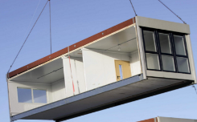
What has nearly been achieved … but is now looking wobbly
Improvement Grant
For remodelling Reception ?
66% provisionally available
but NHSE appointing a surveyor for
re-assessment
Portacabins
Now subject to an additional proposal submission to NHSE detailing justification

Slide 16
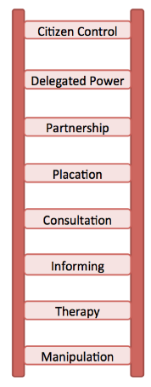
Where did we get to?
Power
The ability or capacity to act or do something effectively ...
Influence
To change the behaviour or thinking …
You don’t have to see the whole staircase in order to take the first step …
Martin Luther King

Slide 17
The Six Steps of Sunbury …
Ovation The sweet smell of success!
Realisation New premises
Expectation NHSE and NHS Property Service
Participation Launch PPG … teamwork, newsletters + meetings
Resolution Set up a PPG … set goals, plans, policies and website
Desperation Patients … concerns, dissatisfaction and frustrations
Staff … frustrations leading to an unhappy workplace

